Slide 1

LECTURE 10: Specifying Systems - Intro
Instructor:
Maria Striki
Presentation: Maria Striki, Ivan Marsic
Rutgers University

Slide 2
Topics
Domains, Phenomena
States, Events
Context Diagrams
Systems and System Descriptions
Basic Formalisms for Specifications
  Boolean Logic
  Finite State Machines

Slide 3
What is a system
System specification: used both for the process of deriving the properties of the software system as well as for the document that describes those properties.
What is valid (true) about the system at the time of system delivery?
Specifying the system: State WHAT we want to achieve, NOT HOW we plan to accomplish it.
Describe the system function, not the system form.
How does the system appear in an equilibrium state? How does it react to a perturbation and what sequence of steps it goes through in order to reach a new equilibrium?
The system specifications are derived from the requirements. The specification must accurately describe the system behavior necessary to satisfy the requirements. Why is the above task the most difficult of all?

Slide 4
What is a system (2)
Describing different interaction scenarios as a set of use cases to develop a software system in an incremental fashion.
Potential Problems:
  What about parts of the environment that are not actors and do not have direct interaction with the software-to-be?
  Use cases describe the sequence of user’s (actor) interaction with the system. However use cases are procedural rather than object-oriented and the road to object-oriented representation may be difficult.
The above render yet another model, the Conceptual Modeling essential: how users and customers need to conceptualize their world?
Problems are in the real world … so we need good abstractions of world phenomena.
In OOW key abstractions are objects and messages. In addition to this abstraction we will need to broaden our horizons and incorporate more abstractions.

Slide 5
What is a system (3)
We partition the world in different domains and consider different phenomena. When identifying this notion, inevitably we make approximations…
Phenomenon: fact/object/occurrence that appears or is perceived to exist, or to be present, or to be the case, when one observes some part of the world.
Categories of phenomena: individuals, relations among individuals, … , causal vs. symbolic, …., deterministic vs. stochastic.
Why random fluctuations in the nature and in society may impact the notion of phenomena?

Slide 6
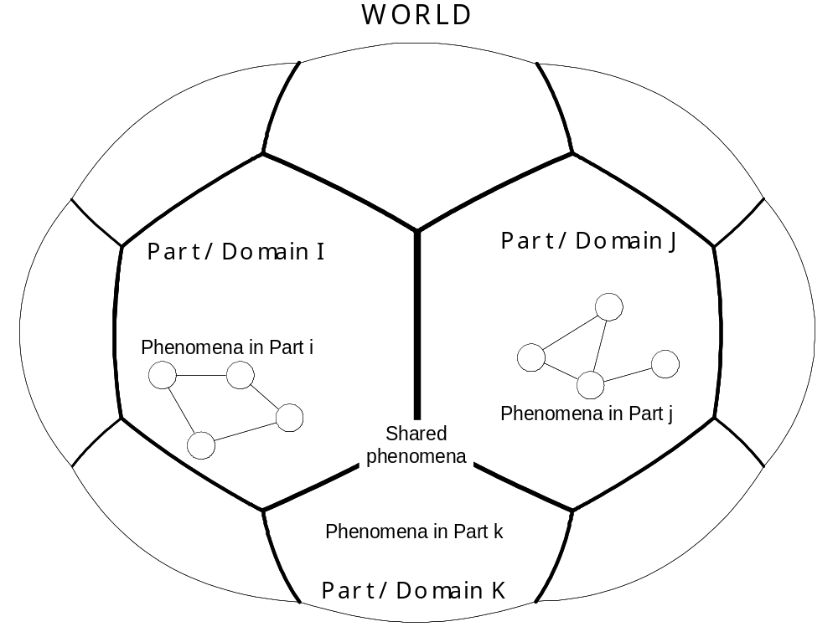
World, Parts, Phenomena

Slide 7
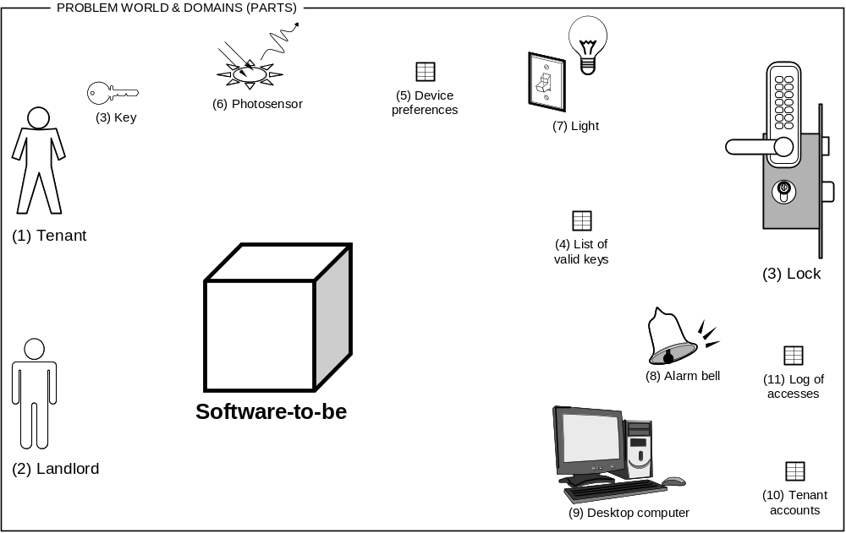
Example of a Problem Domains

Slide 8
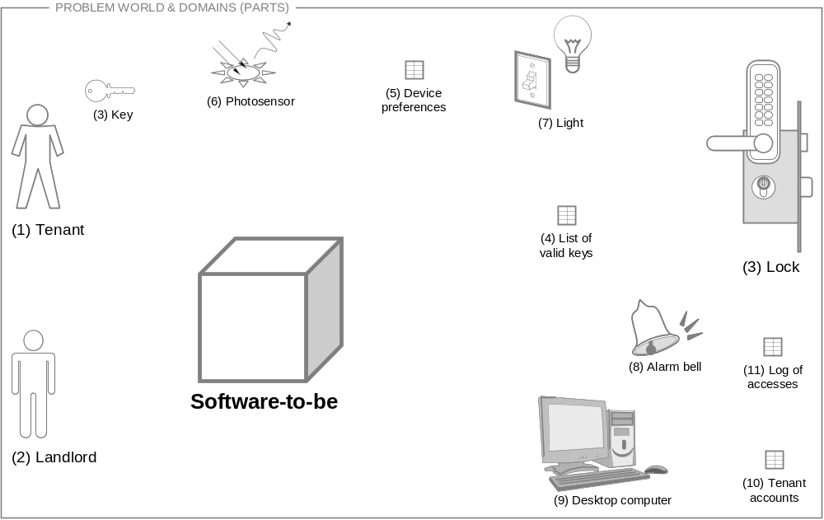
Example of Problem Domains

Slide 9
Example of Problem Domains
(6) Photosensor
(5) Device preferences
(3) Key
(7) Light
(1) Tenant
(4) List of valid keys
(3) Lock
(8) Alarm bell
(11) Log of accesses
Software-to-be
(2) Landlord
(9) Desktop computer
(10) Tenant accounts

Slide 10
Definitions …
A phenomenon is a fact, or object, or occurrence that appears or is perceived to exist
An event is an individual happening, occurring at a particular point in time
  Events are indivisible and instantaneous
A state is a relation among individual entities and values, which can change over time
Individuals are in relation if they share a certain characteristic
  RelationName(Individual₁, …, Individual_{n})

Slide 11
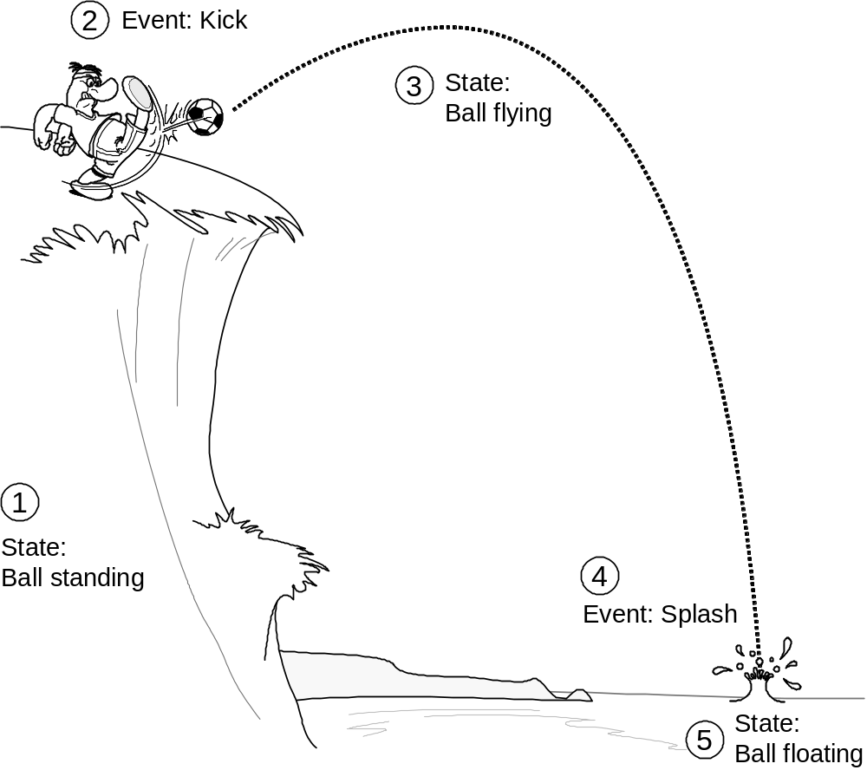
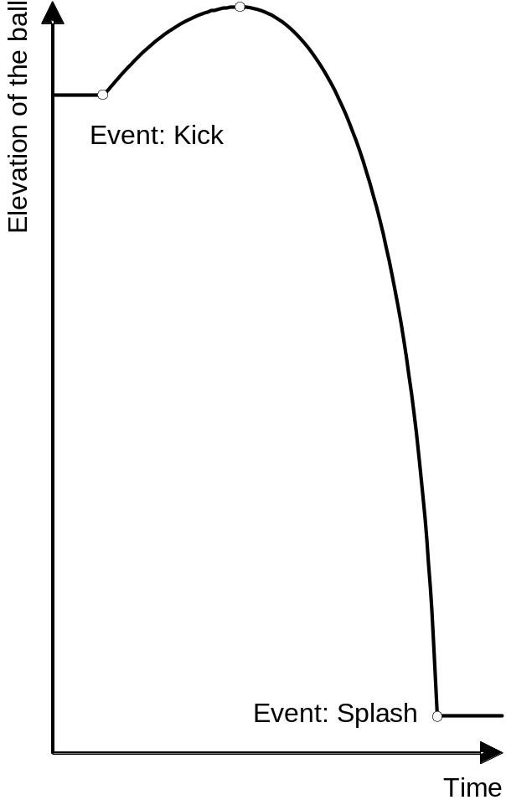
Events
Events take place at transitions between the states

Slide 12
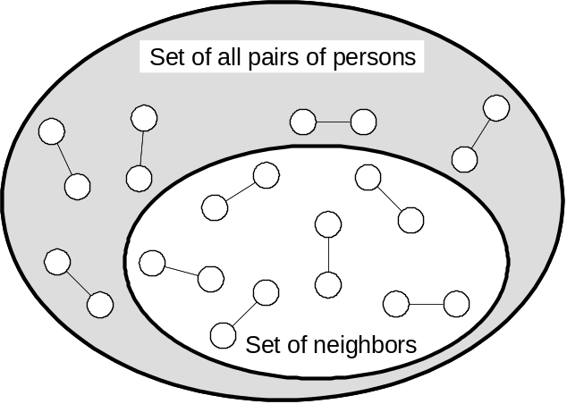
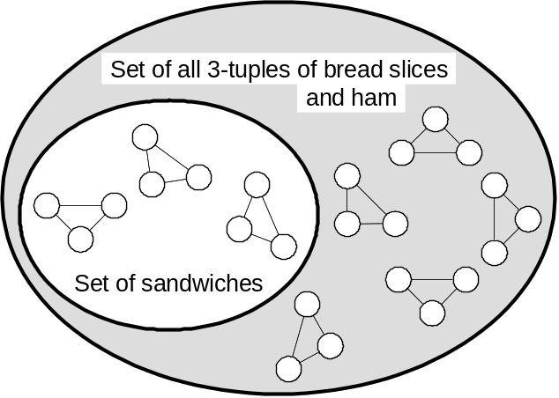
Relations: Examples
Relation: Neighbors (Person_i, Person_j)
Relation:
Sandwich (Bread-slice, Ham-slice, Bread-slice)

Slide 13
Example: States of a DVD Player
State 1: NotPowered (the player is not powered up)
State 2: Powered (the player is powered up)
State 3: Loaded (a disc is in the tray)
State 4: Playing
State 1: NotPoweredEmpty (the player is not powered up and contains no disc)
State 2: NotPoweredLoaded (the player is not powered up and a disc is in the tray)
State 3: PoweredEmpty (the player is powered up and contains no disc)
State 4: PoweredLoaded (the player is powered up and a disc is in the tray)
State 5: Playing

Slide 14
Different Abstractions
(Level of detail)
DVD player
Power
button
Disc
tray
DVD player
Play
button
…
Atomic object
Object composed of parts

Slide 15
Example: States of a DVD Player
System Part (Object) | State Relations
Power button | {Off, On}
Disc tray | {Empty, Loaded}
Play button | {Off, On}
… | …

Slide 16
State Variables
State variable = a physical part or an attribute of an object
State Variable | State Relations
Door lock | {Disarmed, Armed}
Light bulb | {Unlit, Lit}
Counter of failed attempts | {0, 1, …, maxNumOfAttempts}
Auto-lock timer | {0, 1, …, autoLockInterval}

Slide 17

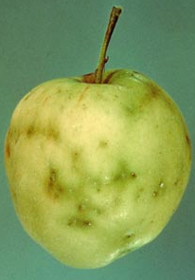
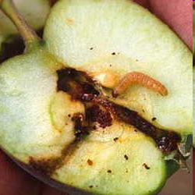
Hidden States
Observable state:
apple’s appearance
Goal:
Find the likelihood of different hidden states, for given observable states
Hidden state:
contains a worm

Slide 18
States Example: Stock Market
Market
index
Market
gate
Open
Closed
1.00
1.01
1.02
Stock_1_Price
Stock_1_Shares
Stock_2_Price
Stock_2_Shares
1.00
1
1.00
1
1.01
2
1.01
2
1.02
3
1.02
3
( prices & number of shares
for all listed stocks )

Slide 19
Defining States
Δ
CountingDown(Timer) =
The relation Equals(Timer, τ) holds true for τ decreasing with time
Idle(Timer) =
The relation Equals(Timer, τ) holds true for τ remaining constant with time
Δ

Slide 20
Microstates and Macrostates
Microstates representing the number of offered shares are aggregated:
OrderPending
OrderExecuted
x − 2
x − 1
x
x + 1
x + 2

Slide 21
Events
Events marking transitions between the states of a trading order:
submit
matched
archive
InPreparation
Pending
Executed
Archived
Event | Description
trade | Causes transition between stock states Buy, Sell, or Hold
submit | Causes transition between trading-order states InPreparation → OrderPending
matched | Causes transition between trading-order states OrderPending → OrderExecuted
… | …
… | …

Slide 22
Events (2)
What is the relationship between events and messages or operations in object-oriented approach?
Message: implies that a signal is sent from one entity to another.
Event: something that happens, it may include one or more individuals but it is not necessarily directed from one individual to another. Events mark transitions between successive states.
With the use of events we can cascade specifying processing details at an early stage of problem definition. With the use case analysis we need to make explicit the sequential processing procedure (“scenarios”) which leads to system operations. This is why use case analysis can become a hurdle when working towards mapping our problem to the OOW.
Messages may not be related to state changes, but events always are. For example, an operation that simply retrieves the value of an object attribute does not affect the object’s state.

Slide 23
Context Diagram: DVD Player
Play button
Context diagram symbols:
enable
disable
notify
A box with a double stripe is a software-to-be domain
(or, machine domain)
start
stop
Disc tray
activate
shut down
Power button
activate
shut down
Display
A box with a single stripe is a designed domain
eject (?)
eject
load
A box with no stripe is a given domain
enable
disable
Eject button
notify

Slide 24
Context Diagram: Stock Trading
Investment portfolio
Trading order
Trader
Software-to-be
(Machine)
Stock exchange
i^{th} stock
Bank

Slide 25
Context Diagram (1)
Problem domain analysis starts by placing the planned system into a context – the environment in which it will work. For this we use context diagrams.
We show different domains as rectangular boxes and connect them via lines to indicate that they share certain phenomena.
A domain is part of the world that can be distinguished. Each domain is a different subject matter appearing in the description of the problem. A domain is described by the phenomena that exist or occur in it.
Domains are classified into three types:
  causal, biddable, lexical.
  Causal: its properties include predictable causal relationships among its causal phenomena.
  Biddable: consists of people, and lacks positive predictable internal causality.
  Lexical: it’s a physical representation of data (of symbolic phenomena).

Slide 26
Context Diagram (2)
Any domain can be a system. A system is an organized or complex whole, interacting in a coordinated way.
Systems are affected by events in their environment. What is the system’s behavior under perturbations?
Most of real world problems require a dynamical model to capture a process which changes over time.
Given an external perturbation or stimulus, the system responds by traversing a set of transient states until it settles at an equilibrium state.

Slide 27
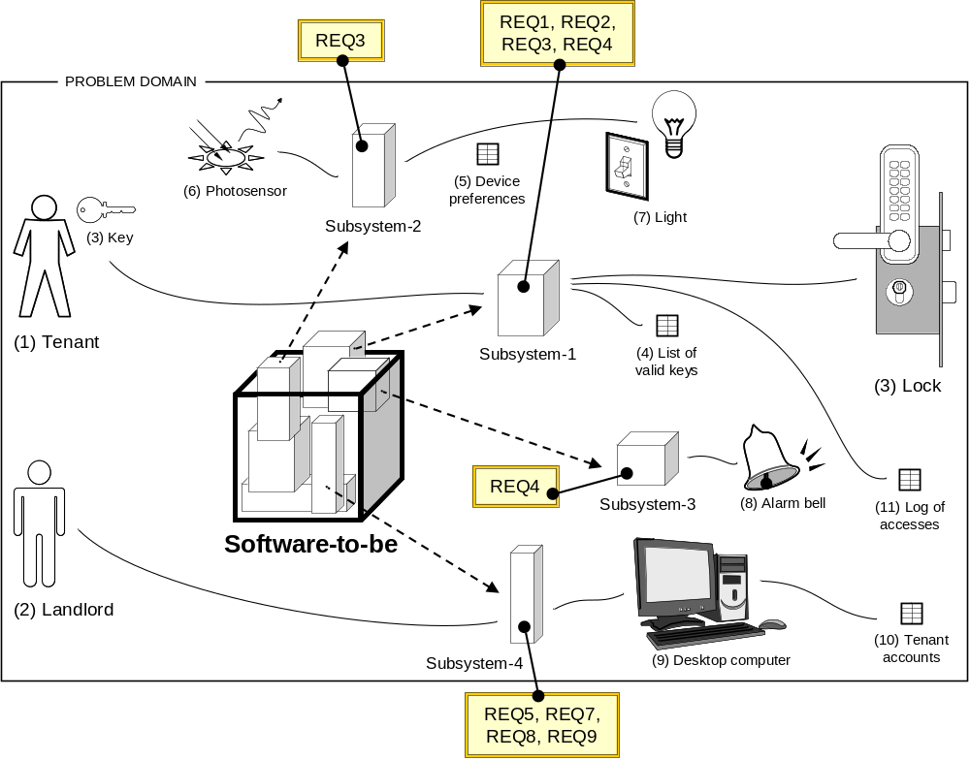
Problem Decomposition

Slide 28
Machine and Problem Domain
(a)
Software-to-be
(The Machine)
a
Problem Domain
b
The
Requirement
Domain properties
seen by the requirement
(b)
Software-to-be
(The Machine)
a
Problem Domain
b
The
Requirement
Specification
Domain properties
seen by the software-to-be
Requirement
a: specification interface phenomena
b: requirement interface phenomena

Slide 29
Boolean Logic
Propositional Logic
∧ conjunction (p and q) | ⇒ implication (if p then q)
∨ disjunction (p or q) | ⇔ biconditional (p if and only if q)
¬ negation (not p) | ≡ equivalence (p is equivalent to q)
Predicate Logic (extends propositional logic with two quantifiers)
∀ universal quantification (for all x, P(x))
∃ existential quantification (there exists x, P(x))

Slide 30
Example: From Req’t to Propositions (Logical Expressions)
Label | Declarative sentence (not necessarily a proposition!)
a | The investor can register with the system
b | The email address entered by the investor exists in real world
c | The email address entered by the investor is external to our website
d | The login ID entered by the investor is unique
e | The password entered by the investor conforms to the guidelines
f | The investor enters his/her first and last name, and other demographic info
g | Registration is successful
h | Account with zero balance is set up for the investor
REQ1 represented as a set of propositions
a
(∀ email)(∀ id)(∀ pwd) [B(email) ∧ C(email) ∧ D(id) ∧ E(pwd) ⇒ g]
f
g ⇒ h

Slide 31
Example: From Req’t to Propositions
Label | Propositions (partial list)
m | The action specified by the investor is “buy”
n | The investor specified the upper bound of the “buy” price
o | The investor specified the lower bound of the “sell” price
Label | Propositions (they complete the above list)
p | The investor requests to place a market order
q | The investor is shown a blank ticket where the trade can be specified (action, symbol, etc.)
r | The most recently retrieved indicative price is shown in the currently open order ticket
s | The symbol SYM specified by the investor is a valid ticker symbol
t | The current indicative price that is obtained from the exchange
u | The system executes the trade
v | The system calculates the player’s account new balance
w | The system issues a confirmation about the outcome of the transaction
x | The system archives the transaction
REQ2 represented as a set of propositions
p ⇒ q ∧ r
s
y = v ∧ {¬(n ∨ o) ∨ [(o ∧ p ∨ ¬o ∧ q) ∧ (∃ IP)(LB ≤ IP ≤ UB)]}
z = ¬m ∨ {[¬n ∧ (VOL × IP ≤ BAL)] ∨ [n ∧ (VOL × UB ≤ BAL)]}
y ∧ z ⇒ u
u ⇒ v ∧ w ∧ x

Slide 32
FSM State Transition Diagram
lock
unlock
unlock
Closed
Open
lock
Start
v = (input-key ∈ Valid-keys)
i = (input-key ∉ Valid-keys)
M = maxNumOfAttempts
v
i
i
0
1
2
M
v
v

Slide 33
FSMs with Outputs
lock
unlock / beep
unlock
Closed
Open
(a)
lock / beep
lock
unlock [key ∈ Valid-keys] / beep
unlock
Closed
Open
(b)
lock / beep

